Slide 1

DriverPass System Analysis
Deonte Tate
Notes:
[No speaker notes required for this slide.]

Slide 2

System Requirements
Functional Requirements:
The system will allow students to register, login, access learning modules, and schedule lessons.
The system will automatically assign instructors and vehicles based on availability.
Generate real-time progress reports for students, including quiz scores, lesson completion, and instructor feedback.
Non-Functional Requirements:
The system should support at least 500 concurrent users with page load times less than or equal to 2 seconds.
Use encrypted communication (HTTPS with TLS 1.3) and secure data storage.
Be compatible across modern browsers (Chrome, Edge, Safari, Firefox) and responsive on desktop, tablet, and mobile.
Notes:
For DriverPass, we selected functional requirements that focus on what users can actually do on the system. Students need to be able to register, log in, and manage their profiles. They also need to access online lessons, quizzes, and practice tests, which directly supports student preparedness. Scheduling features let students set, change, or cancel driving lessons, while automatic assignment of instructors and vehicles reduces administrative workload for staff.
The nonfunctional requirements ensure the system works smoothly and safely. It must handle at least 500 users at the same time without slowing down, and it should work on all major browsers and devices so students and staff can access it anywhere. Security is critical, so all data is encrypted and communications are protected. Finally, cloud hosting ensures the system is reliable and always available.
Together, these functional and nonfunctional requirements meet DriverPass’s needs by improving student learning, streamlining scheduling, and keeping the platform safe and dependable.

Slide 3
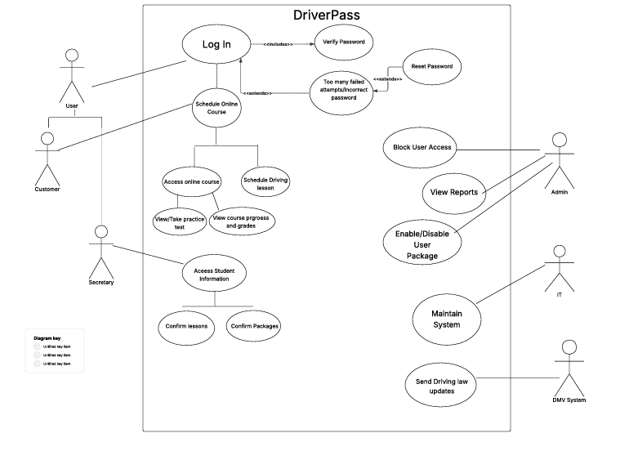
Use Case Diagram
Notes:
This diagram shows how DriverPass supports students, staff, and administrators. Students can log in to schedule courses or driving lessons, take practice tests, and track their progress. Secretaries confirm lessons and packages, administrators manage access and reports, IT keeps the system running, and the DMV provides law updates. The design ensures students can learn effectively while staff and administrators have the tools needed to manage services and keep information accurate.

Slide 4
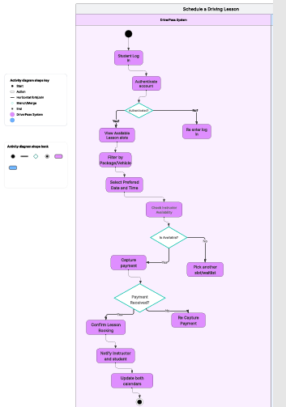
Activity Diagram
Notes:
This diagram breaks down the process of scheduling a driving lesson. A student logs in, selects a package, chooses a date and time, and the system checks if an instructor is available. If available, payment is captured and the lesson is confirmed. Both the instructor and student are notified, and their calendars are updated. This design ensures DriverPass can smoothly handle scheduling while keeping information accurate for both students and instructors.

Slide 5
Security
Keeping DriverPass safe and secure is a top priority. The system is designed to protect user information, prevent unauthorized access, and ensure that students and staff can use the platform with confidence.
Users must create strong passwords and admins/IT staff use multi-factor authentication.
All information sent and stored is encrypted to prevent unauthorized access.
Password resets are handled through secure email links.
Accounts are temporarily locked after multiple failed login attempts, with notifications sent to the user and admin.
System activity is monitored to detect unusual behavior or potential security issues.
Notes:
Security was a major consideration in designing DriverPass because we wanted both students and staff to feel confident using the system. We required strong passwords for all users and added extra verification for administrators and IT staff to protect sensitive information.
All personal and learning data is kept safe both when it is stored and when it is being sent over the internet. If someone tries to log in multiple times unsuccessfully, the account is temporarily locked and notifications are sent to both the user and the system administrators. This helps prevent unauthorized access.
The system also watches for unusual activity, which allows staff to address potential problems quickly. Finally, we made sure that users can safely reset forgotten passwords through a secure email process.
These security measures work together to keep student progress, personal information, and staff operations safe, meeting the client’s need for a reliable and trustworthy platform.

Slide 6
System Limitations
Version 1 will not have a native mobile app; users must access the system via a web browser.
The integration with DMV (Department of Motor Vehicles) databases may be limited if automatic connections are unavailable; some updates may need to be manual.
Peak usage times may cause slight system slowdowns.
Budget constraints may limit advanced analytics and additional DMV integrations.
Notes:
While DriverPass offers many helpful features, there are some limitations in this first version. Users will need to use a web browser to access the system because a mobile app isn’t available yet. Some updates from DMV databases may require manual entry if automatic connections aren’t available.
During very busy times, the system may slow down slightly. Also, budget limits mean we can’t include some advanced analytics or extra DMV integrations in this version.
Even with these limitations, the system still supports the main goals: helping students learn to drive, making lesson scheduling easier, and keeping data safe and secure.

